Slide 1
Technin 510 Week 9
Firebase Database
12/1/21

Slide 2
Today
Databases
Database Events
Relational vs non-Relational
Authentication
Lunch
Technin510 L9 Firebase Database

Slide 3



Addition of Database from Last Week
client
server
database

Slide 4

Database Events
client
server
database
An event occurs, new data is sent to Firebase
Database content is set or updated
A message is sent to all registered clients
A server-sent event (SSE) is triggered, callback function is fired
Sending motion sensor data to firebase: https://codepen.io/wesleybeckner/pen/xxOMGBq
Receiving motion sensor data from firebase: https://codepen.io/wesleybeckner/pen/vYKvVVR

Slide 5
Database Events
An event occurs, new data is sent to Firebase
var dbRef = firebase.database().ref('/’);
dbRef.set(last60IntervalAcc)
Database content is set or updated
A message is sent to all registered clients
A server-sent event (SSE) is triggered, callback function is fired
firebase.initializeApp(config);
var dbRef = firebase.database().ref('/');
dbRef.on("value", getDataFromFirebase);

Slide 6
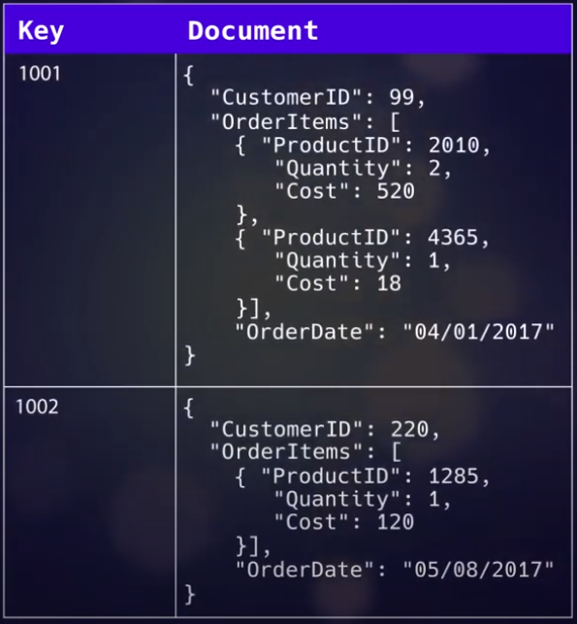

Relational (SQL) vs non-Relational (noSQL) databases
Relational Pros
Simplicity
Expected data structures
Accuracy and Integrity
Because we have schema that define how our data should look
Flexibility
Because of relations between data tables, we can grow our database
Examples
MySQL
Microsoft SQL
Oracle Database
Non-Relational Pros
Unstructured
Collections instead of tables
No schema
Agility
Readability
Examples
MongoDB
DocumentDB (Amazon)
Cassandra (FB/Apache)
Firebase
Non-relational example
Source: https://www.youtube.com/watch?v=iUtQN8LMEp0&ab_channel=Jelvix
SQL vs no SQL: https://www.youtube.com/watch?v=ZS_kXvOeQ5Y&ab_channel=Academind

Slide 7

Basic Authentication
client
server
database
User (already registered) enters username and password
Server checks correctness and returns requested service or information if access is granted
Browser (client) displays the output of the service or the return information

Slide 8
Google Open Authentication (OAuth) Example on Firebase
The user wants to:
Log into Site A by proving they have an account on Site B
or
Enhance Site A by allowing communication with Site B
User: the person who has to log in
Consumer: (Site A) the application that will access data from elsewhere (e.g. your codepen)
Service Provider: (Site B) the place the user has to log into (e.g. FB, Google)

Slide 9


Google Open Authentication (OAuth) Example on Firebase
I want to give you access
Here’s an authorization token
Request + token
Do you want to grant access?
Requested information
Yes, grant access
I want access to this user’s data
Cookies vs sessions vs tokens: https://www.youtube.com/watch?v=44c1t_cKylo&ab_channel=ValentinDespa

